Slide 1

CSCI 434
Automated Network Classification via Machine Learning

Slide 2
Purpose
Monitor network traffic from three popular web services
Produce features from captured data and build a model to automatically predict which website the traffic originated from
Understand distinctions between different service types at a network level

Slide 3
Data Acquisition
Wireshark was used in an isolated virtual machine running a minimal Linux distribution
Real users were instructed to conduct normal activity on three different sites:
Wikipedia
YouTube
Agar.io
Network traffic was recorded and saved; approx. 1 hour of training data for each.

Slide 4
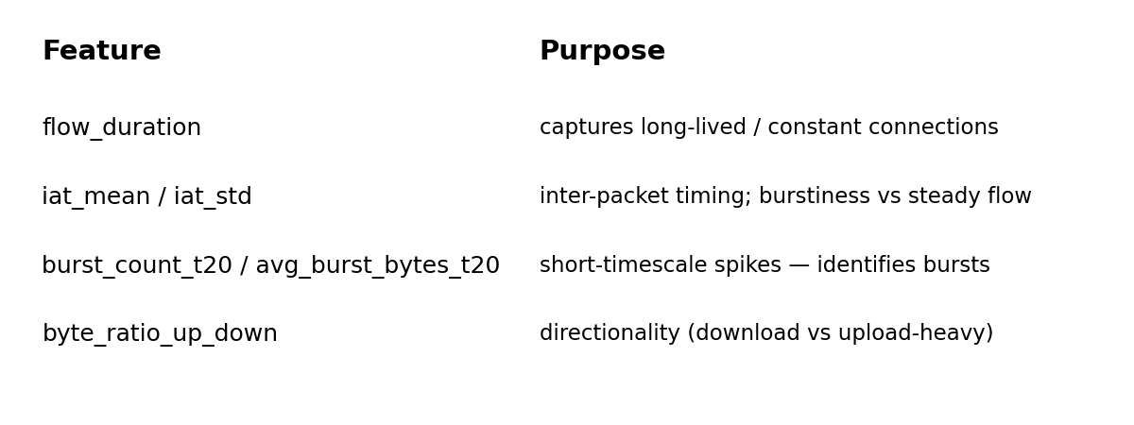
Feature Engineering
Objective: 3-class classification; distinguish between:
Constant traffic
“Bursty” traffic
Download-heavy traffic
Notes:
A network flow in our pipeline is the aggregation of packets that share a consistent five-tuple (source IP, destination IP, source port, destination port, protocol) and are temporally contiguous within a short inactivity timeout. We extract flow-level features rather than working at raw packet-level because flows summarize the session behavior we care about: aggregate timing statistics, burst patterns, byte/packet counts, and directionality. This abstraction reduces noise from individual packet jitter and produces compact observations suitable for classical ML models and explainability methods.
Timing features form the backbone of our representation. For each flow we compute inter-arrival time (IAT) summaries (mean, std, cv, skew, kurtosis), percentiles, and packet-size-conditioned timing bins. These capture cadence and rhythm — for example, Wikipedia traffic shows bursty request patterns with short IATs followed by longer silences, whereas Agario flows are more constant. IAT-derived features consistently rank high in permutation importance, which confirms their predictive value.
Burst and multi-scale burst features explicitly quantify short, high-activity periods inside flows. We detect bursts using an IAT threshold and compute burst counts, average bytes/packets per burst, and coefficients of variation for burst lengths at multiple time scales (e.g., 20ms, 50ms, 200ms windows). Multi-scale measurements let the model see both micro-bursts and longer download-style bursts; that helps discriminate services that have short interactive bursts versus sustained downloads.
Size and payload-aggregate features (total bytes, bytes per packet, packet-size percentiles) capture volume and distributional shape. Heavy-tailed behavior is common, so we compute log1p transforms for these columns before modeling. We also include ratio features (bytes-up/down, packet-rate-up/down) and direction-conditioned statistics because client-server vs peer-to-peer patterns show distinct directional asymmetries that are diagnostically useful for classifying services.
We pay special attention to preprocessing and robustness. Heavy-tailed columns are log-transformed to stabilize variance and make model fitting more numerically robust. Features are standardized with a saved scaler so production inference remains consistent. To avoid leakage we use StratifiedGroupKFold grouped by source_file during CV, and in-fold oversampling when training to balance classes without leaking distributional information across folds. Permutation importance and per-class importances are used to sanity-check that high-importance features make domain sense rather than reflecting dataset artifacts. flow_duration
flow_duration is the total elapsed time from the first packet to the last packet in a flow. It’s a simple but powerful summary of session length: short durations often indicate brief interactive exchanges or failed/quick connections, while long durations indicate sustained downloads or prolonged interactions. In our dataset, Wikipedia flows often show longer durations when a page and its assets are being downloaded, whereas Agario flows can be either short (quick joins) or long (extended gameplay). Thus flow_duration helps separate long, sustained download-like flows (more likely Wikipedia) from many short or mid-length interactive sessions (often Agario), but it is not perfectly discriminative on its own.
iat_mean / iat_std
These inter-arrival time statistics summarize packet timing within the flow. iat_mean gives the average gap between consecutive packets, while iat_std measures timing variability. Low iat_mean and low iat_std indicate a steady stream of packets (constant behavior), whereas low mean but high std indicates bursts separated by quiet periods. In our experiments, Agario tends toward smaller mean IATs during active gameplay with relatively steady updates, while Wikipedia downloads produce short bursts (low mean) but higher std and CV because the page fetch causes a concentrated burst followed by silence. Together, mean and std help the model distinguish rhythmic gameplay traffic from bursty HTTP transfers.
burst_count_t20 / avg_burst_bytes_t20
These multi-scale burst features are computed using a short time window (20ms) to detect micro-bursts. burst_count_t20 counts how many such bursts occur in the flow; avg_burst_bytes_t20 measures the average bytes sent during those bursts. A high burst_count with small avg_burst_bytes suggests many short control/interactive messages; few bursts with large avg_burst_bytes suggests a small number of heavy transfers. Agario often exhibits many small bursts as clients exchange game-state updates frequently, producing higher burst_count_t20 but lower avg_burst_bytes_t20. Wikipedia page fetches often cause fewer but larger bursts (lower count, larger average bytes) as resources are transferred in denser packets.
byte_ratio_up_down
This is the ratio of bytes sent upstream to bytes sent downstream (or vice versa depending on naming). It captures asymmetry in client/server behavior. Client-heavy uploads (higher upstream ratio) might indicate streaming or interactive uploads, while downstream-dominant flows indicate downloads or content delivery. Wikipedia is typically downstream-heavy (low up/down ratio) because clients download pages and assets, while Agario gameplay can show higher upstream signalling (player actions) combined with downstream updates; in practice, Agario flows often have a more balanced or higher up/down ratio compared to Wikipedia, making this ratio a useful directional discriminator when combined with timing features.

Slide 5
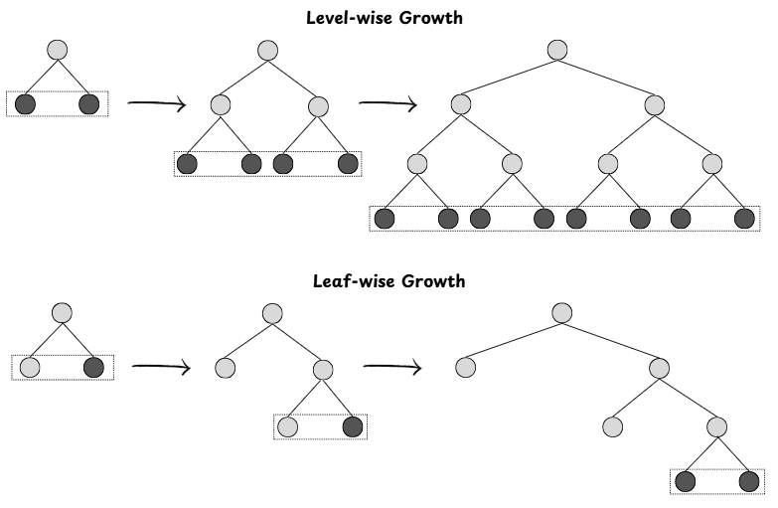
Model: LightGBM
Family: Gradient-boosted decision trees
Learns by sequentially adding trees that correct previous errors
Handles nonlinear features well
LightGBM build many small decision trees. Each tree focuses on the mistakes the previous trees made; trees are added until errors shrink. Final prediction is the sum of tree outputs, converted to probabilities.
https://medium.com/@origoldbsc/understanding-lightgbm-a-friendly-guide-9fe08db5effa
Notes:
LightGBM was chosen because it delivered the best predictive performance on our grouped CV experiments: roughly 83% accuracy and a macro‑F1 around 0.77. Those gains were consistent across folds and noticeably higher than the linear baselines (Ridge and Logistic). Practically, this means LightGBM is better at capturing the non‑linear relationships and feature interactions present in our timing and burst features, which the linear models simply cannot represent without heavy manual feature engineering.
A second reason was iteration speed and scalability. LightGBM’s histogram-based, leaf-wise boosting trains and predicts substantially faster than a comparable bagged forest when we need deep trees or many estimators. Faster training let us run more cross‑validation folds, permutation importance tests, and hyperparameter tweaks in the same time budget, which materially improved our ability to validate and debug models during development.
Regularization and stability were important in this problem because classes are imbalanced and some features are heavy‑tailed. LightGBM provides straightforward regularization (learning rate, L1/L2) and works well with early stopping, which gave stable fold-level behavior without aggressive manual pruning. Combined with StratifiedGroupKFold and in‑fold oversampling, this helped avoid overfitting to a single source file or to idiosyncratic flows in the dataset.
Finally, the feature set contains many subtle numeric interactions (directional burst ratios, CV/skew of inter-arrival times, multi‑scale burst counts) that are naturally modeled by boosted trees. LightGBM’s boosted trees focus model capacity on hard examples and can represent those interactions compactly; Random Forests, while effective, often needed many more trees or deeper trees to reach similar error rates and were slower in our tuned tests. This made LightGBM the better practical choice for both accuracy and engineering turnaround.
Anticipated questions: Random Forest performed well but did not match LightGBM’s CV means on the same features and folds; RF tends to be less sample‑efficient for hard examples because it averages many full trees instead of iteratively focusing on misclassified cases. XGBoost often ties LightGBM in accuracy but ran slower in our environment; CatBoost could be competitive if we add many categorical flow labels, but our pipeline is numeric/timing heavy so LightGBM gave the best speed/accuracy tradeoff. On overfitting: we mitigated this with group-aware CV, in‑fold oversampling, early stopping, and permutation importance checks — the diagnostics point to plausible, interpretable drivers (timing and burst stats) rather than single‑feature leaks.

Slide 6
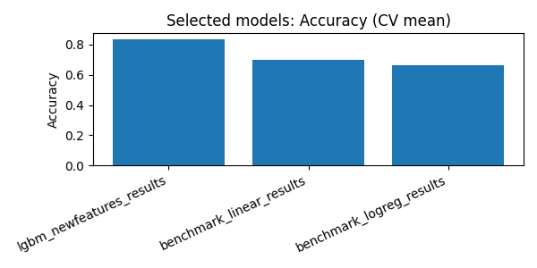
Results
Best model: LightGBM (with new burst features)
Benchmarks:
Linear Accuracy: 0.6962, Macro-F1: 0.6583
Logistic Accuracy: 0.6609, Macro-F1: 0.6274
Per-class:
Youtube F1: 0.90
Wikipedia F1: 0.80
Agar.io F1: 0.62

Slide 7
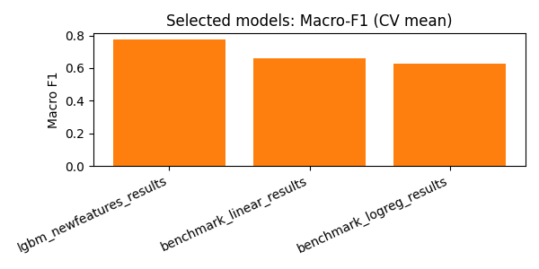
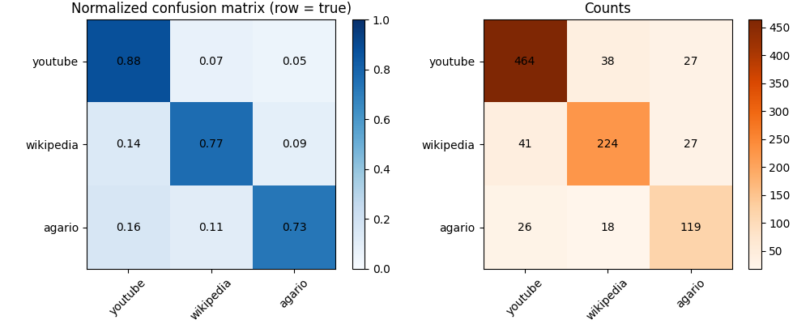
Results

Slide 8
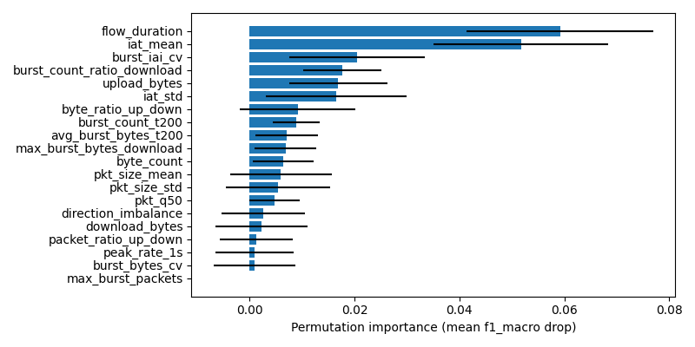
Features

Slide 9
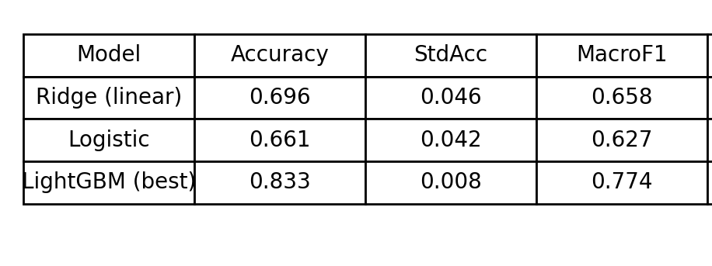
Conclusions
The LightGBM model achieves substantially better multiclass performance than linear baselines.
Timing features (flow duration, IAT statistics) and a small set of burst features are the primary drivers of performance.
Misclassifications concentrate between Wikipedia and Agario
Notes:
High-level flow overlap:
At the flow level Agario and Wikipedia can produce superficially similar summaries: both can show medium-duration flows with intermittent bursts and mixed upstream/downstream packet counts. In our aggregated metrics this translates to overlapping ranges for features like flow duration, total bytes, and average packets per burst. When those global statistics align. for example, a medium-duration Wikipedia download captured with client-side interactivity or an Agario session with periodic large state updates, the classifier sees feature vectors that sit near the decision boundary, increasing confusion.
Timing & burst patterns
Although we designed burst and multi-scale IAT features to separate “constant” vs “bursty” behaviors, real-world traffic is messy. Wikipedia traffic can look bursty at short scales (a fetch with a flurry of small packets followed by idle time), while Agario gameplay sometimes issues periodic larger updates that mimic download bursts. At packet/IAT scale the distributions (IAT means, CV, skew) can therefore overlap: both services may produce short IAT spikes followed by longer sleeps depending on client behavior and server-side pacing. This micro-level similarity is a core reason for misclassification.
Packet size & directionality ambiguities
Packet-size statistics add signal but not perfect separation. Wikipedia tends to produce downstream-dominant flows with large payloads, yet some Agario flows also have large downstream updates (game state, textures) and a significant downstream skew when a client retrieves assets. Directional ratios (bytes_up/down) and percentiles help but are not absolute. captured sample timing, HTTP compression, or retransmissions can alter size profiles so that the two classes overlap in feature space.
Dataset and capture artifacts that amplify confusion
Practical capture conditions also contribute: network-level artifacts like fragmentation, MTU differences, and variable browser behavior can change packetization. If both services were recorded under similar network conditions or during overlapping client behaviors (e.g., many clients using the same browser), the captured flows will be more similar. Additionally, previously observed dataset contamination (a dominating pcap) demonstrated how single-source idiosyncrasies can skew model confidence; removing that pcap reduced some false signals but the agario/wikipedia boundary remains inherently fuzzy.
How we can mitigate and diagnose further
There are practical ways to reduce confusion: add higher-resolution sequence features (e.g., first‑N packet IATs and sizes as ordered vectors, or small RNN/CNN on packet sequences) to capture the temporal pattern rather than only aggregates; add protocol-level features (HTTP headers, TLS SNI, TCP flags) where available to provide orthogonal signal; and enrich the dataset with more varied captures per class to widen the model’s view of typical within-class variability. Finally, per-sample explanations (SHAP or per-class permutation) help identify which flows sit near the boundary and why, which can guide targeted data collection or engineered features.

